Slide 1
24MAT180
S2 P & M

Slide 2



Slide 3


Slide 4


Slide 5
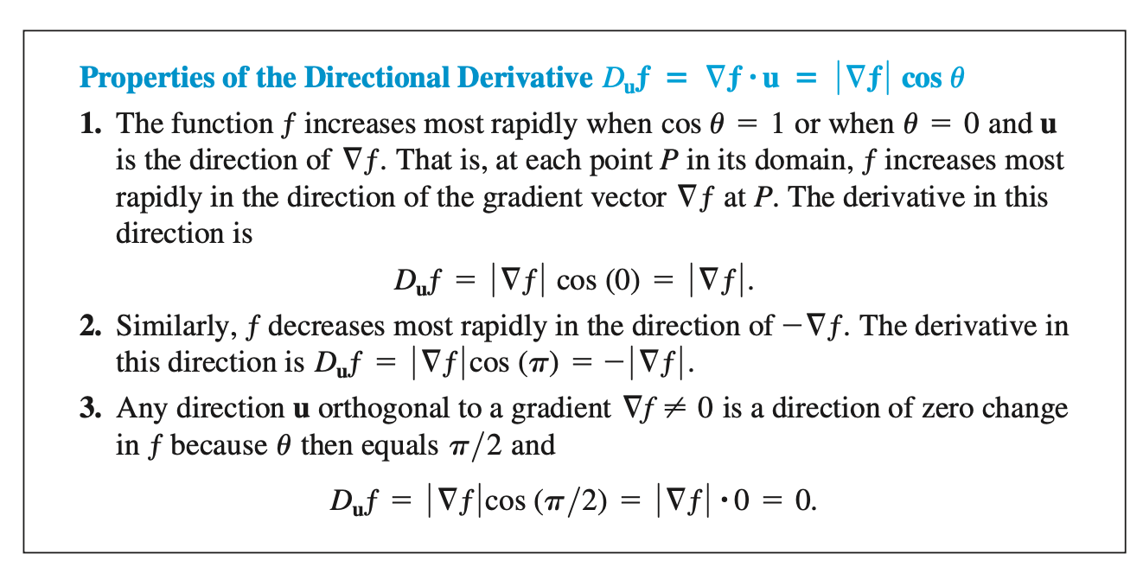

Slide 6


Slide 7
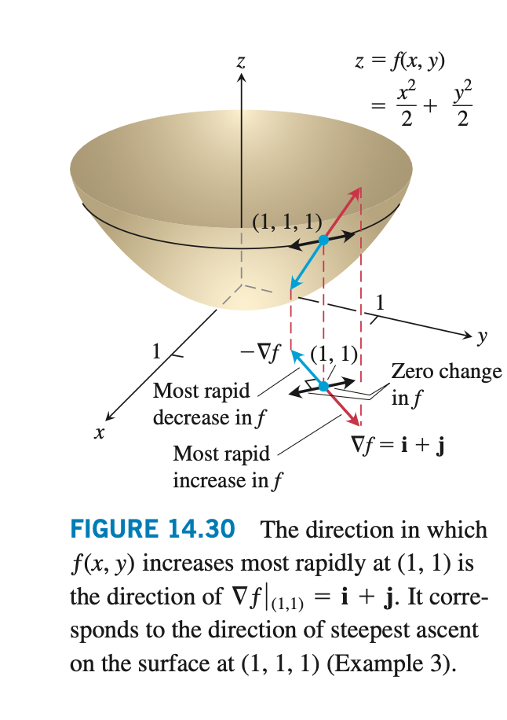

Slide 8
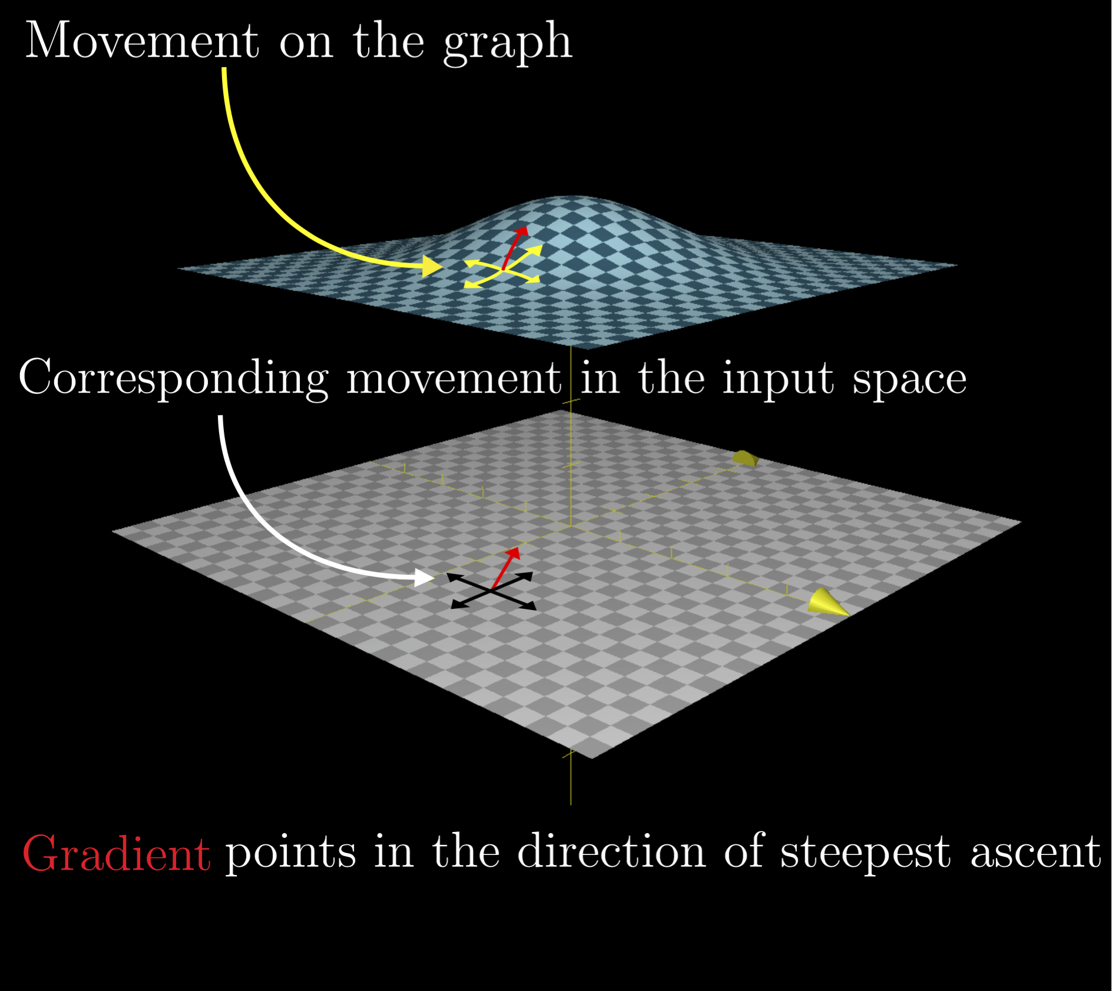

Slide 9
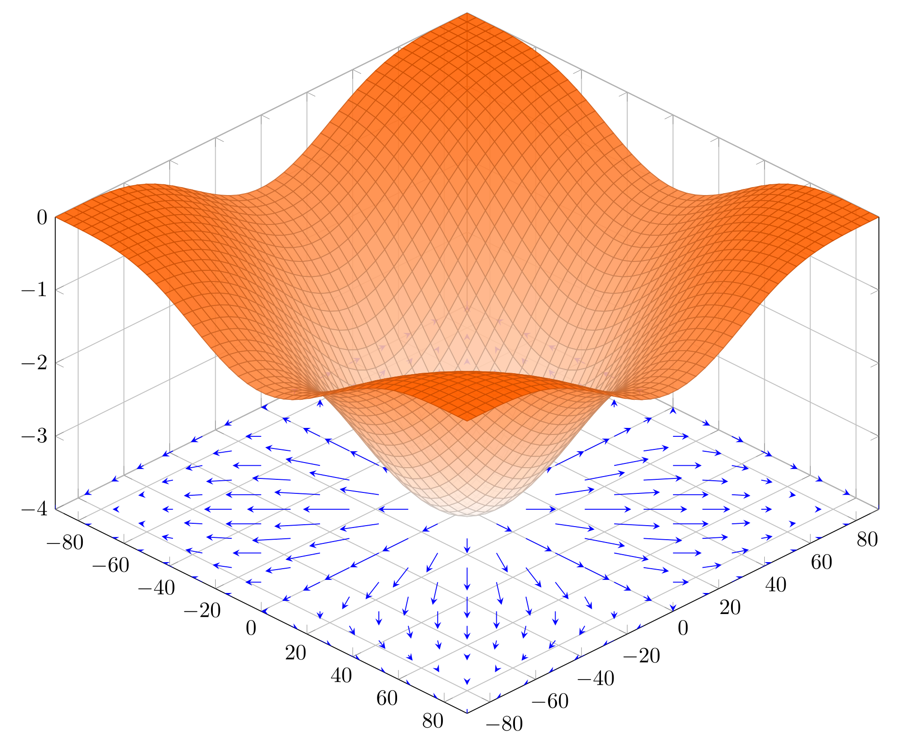

Slide 10
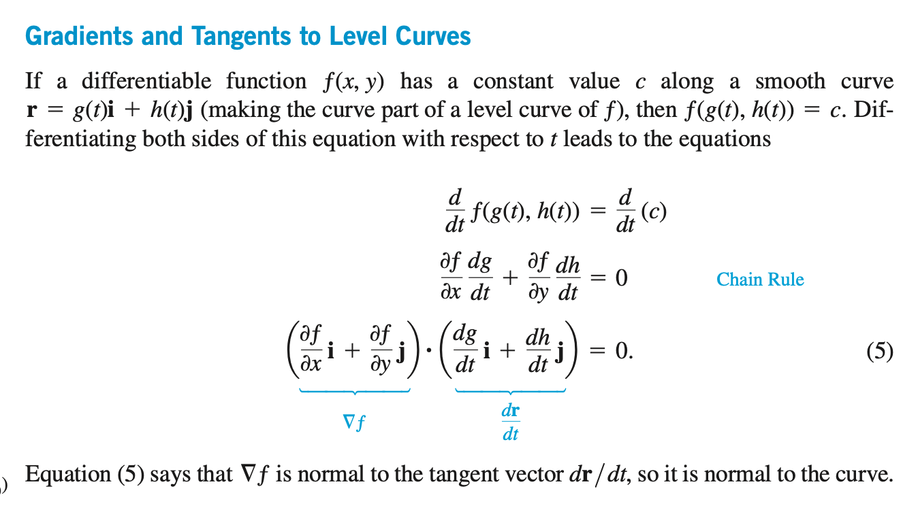

Slide 11

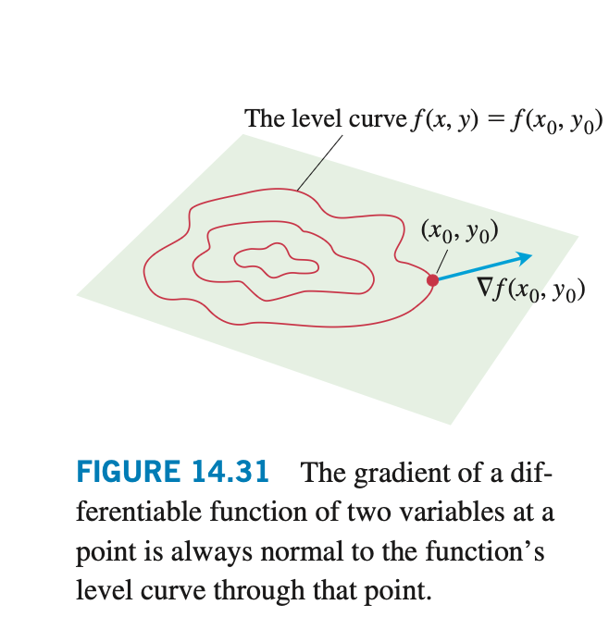

Slide 12


Slide 13
